Slide 2
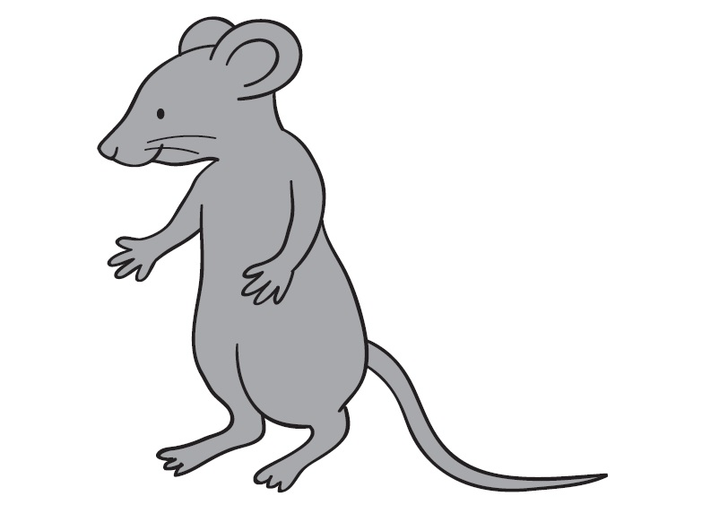

Slide 3
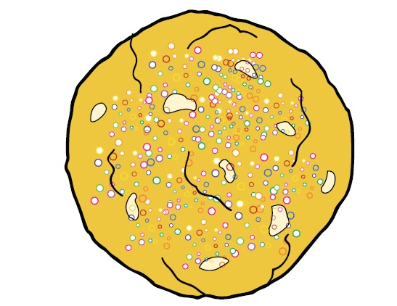

Slide 10
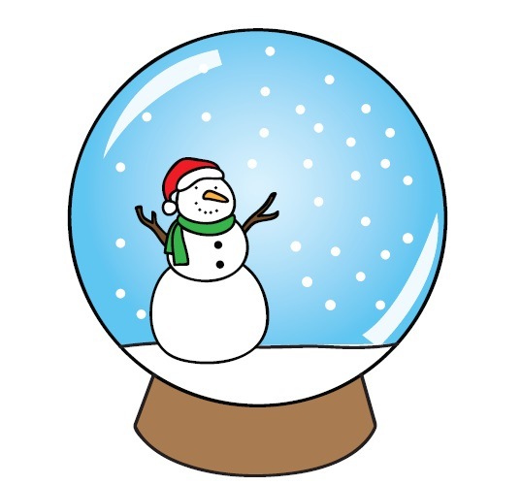

Slide 11
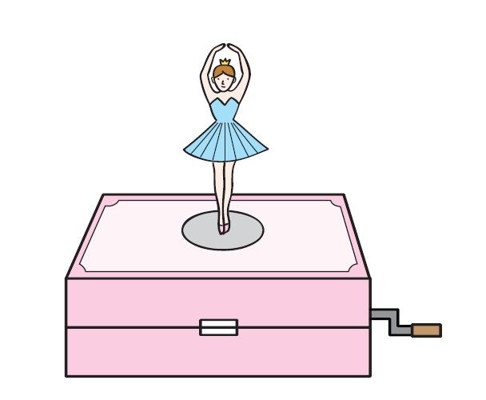

Slide 14
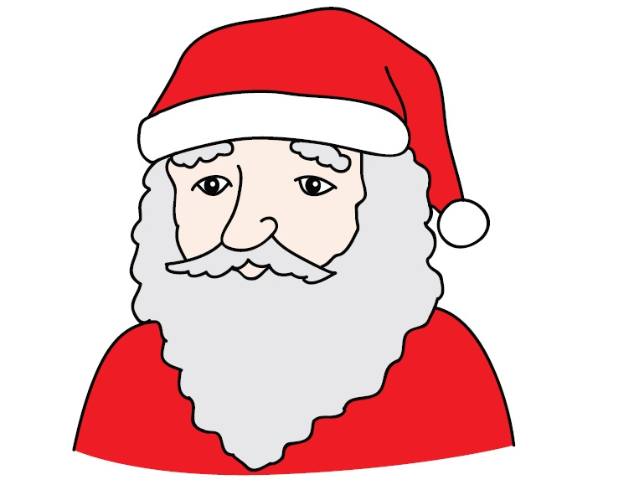

Slide 15
A MOUSE

Slide 16
A COOKIE

Slide 17
HOT COCOA

Slide 18
A CANDY CANE

Slide 19
JINGLE BELLS

Slide 20
A CANDLE

Slide 21
AN ANGEL

Slide 22
A STOCKING

Slide 23
A SNOW GLOBE

Slide 24
A MUSIC BOX

Slide 25
A CHRISTMAS TREE

Slide 26
PRESENTS

Slide 27
SANTA CLAUS

